Slide 1
Educational Game for VR
Developed and Presented by Donald Brant, Alan Lam, & Jose Romero
Notes:
Hello. I’m Donald Brant and here with me are my team members Alan Lam and Jose Romero. For our project we’ve set out to develop an educationial game for VR.

Slide 2
Project Goals
Develop an immersive, educational PC VR experiences
Provide educational tutorials to teach life skills such as cooking and car maintenance
Provide a simple method for reviewing flashcards in VR
Notes:
Our main goal with this project is to develop an educational tool that leverages VR’s strength of immersion in order to create a fun and engaging learning experience for our users.
To that end we’re creating directed tutorials that walk users through learning life skills such as cooking and performing simple car maintenance.
We’re also developing a flashcard mode that aims to provide a traditional flashcard review experience with digital convenience.

Slide 3

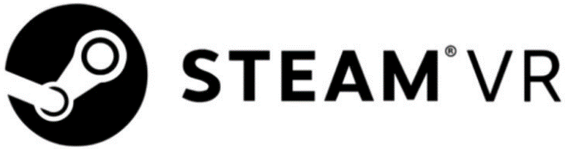
Technologies Used
Notes:
We’ve built our game in Unity, an extremely popular multiplatform game engine used in a wide range of popular games from Temple Run to Beat Saber.
On top of that we’ve utilized SteamVR integration through the SteamVR Unity plugin which allows us to greatly simplify the process of targeting multiple VR platforms by baking in HMD support for all major VR platforms and abstracting or generalizing controls between those platforms.

Slide 4
Implemented Flashcard Features
Easy input method for users to create custom flashcards (.csv)
Dynamic ‘Omnicard’ display
Input to allow the user to move onto the next card
Notes:
This sprint we’ve started to implement the flashcard level.
We’ve already implemented a method for user input of custom flashcards which we’re handling through a CSV file in the game directory. Users can simply edit this file with their spreadsheet software of choice, putting the front text for cards in the first column and the back text for cards in the second column.
To the display the cards we determined that a stack of n cards in VR would be a bit… cumbersome so we opted for a single card solution that I’ve dubbed the Omnicard. The Omnicard displays the text for one flashcard entry at a time.
Once a user is ready for the next card they can simply press a button and the Omnicard will update.
And here is what that looks like.

Slide 5
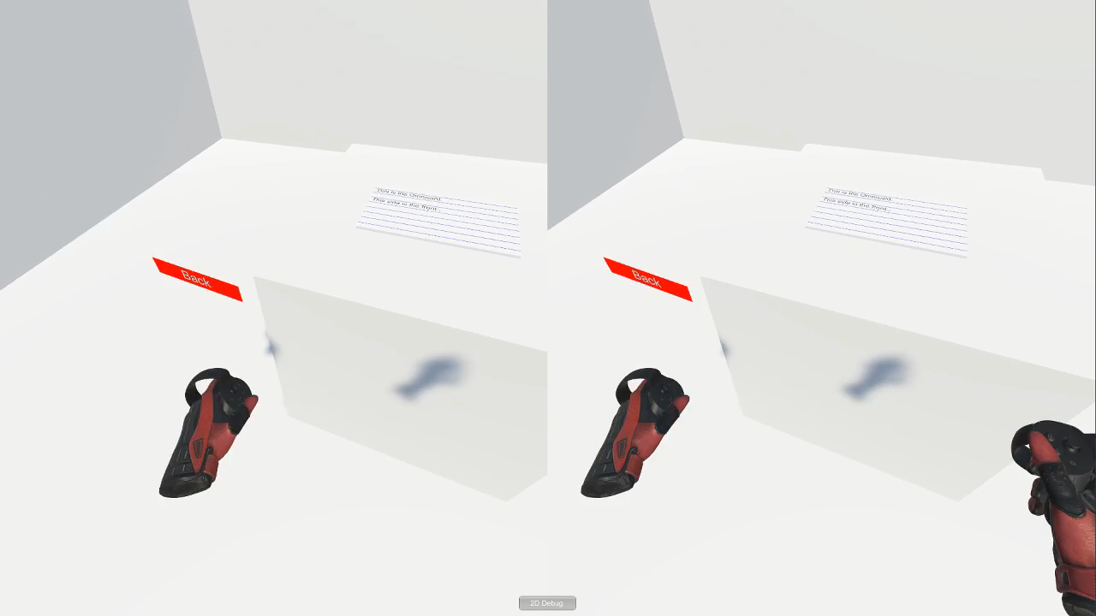

Slide 6
Upcoming Flashcard Features
Card shuffling
Allowing users to mark cards as ‘learned’
Built in flashcard sets associated with the other levels of the game
Notes:
So what we’ve got so far is a pretty simple implementation. We have that instructional text, followed by the custom flashcard entries which just loop forever. Once you reach the last card you return to the first. As we continue to develop this feature we have a few key bits of functionality we’d like to add.
Card shuffling is an obvious next step that will help add challenge and variety to review sessions.
We’d also like to add the ability to mark cards as ‘learned’ to have them removed from the rotation so our users can focus more on the cards that are giving them trouble.
Finally, as we continue to develop our tutorial levels we’d like to create built in flashcard sets to complement those levels.

